Slide 1
Diabetes and Tuberculosis Patients Data Analysis and Interpretation
Here is where our presentation begins

Slide 2
Table of contents
01
02
03
04
Introduction
Problem Survey
Literature Review
Data Trends
05
Analysis
06
References

Slide 3
Whoa!
Mohammed Huzaif S-RVCE23BIS125
Aditi Shastri-RVCE23BIS116
Kavya Thrivedi-RVCE23BIS015

Slide 4
01
Introduction

Slide 5
What are we going to learn?
In the realm of data analysis, Python emerges as a tool not just for coding but for unveiling unexpected correlations. Today, our focus revolves around deciphering the connection between two seemingly disparate health conditions: Diabetes Mellitus (DM) and Tuberculosis (TB).
Our endeavor encompasses the use of Python libraries applied to real-world datasets. This presentation aims not only to showcase technical expertise but also to shed light on the profound implications that this correlation holds for healthcare strategies and the lives of those affected.

Slide 6
Main concepts
Statistic
Probability
Statistics is a branch of mathematics that involves the collection, analysis, interpretation, presentation, and organization of data..
Probability is a measure that quantifies the likelihood or chance of a particular event occurring.

Slide 7
Most commonly used charts
Line chart
Column chart
Pie chart

Slide 8
Other chart types
Donut chart
Area chart
Pyramid chart
Bar chart

Slide 9
The concepts of statistics
Population
Sample
Variable
Mean
Distribution
Deviation

Slide 10
— Clive Humby
“Data is the new oil."

Slide 11

A picture always reinforces
the concept
Images reveal large amounts of data, so remember: use an image instead of a long text. Your audience will appreciate it

Slide 12
Statistical process
Introduction
Analysis
Methodology
Conclusion

Slide 13

02
Problem Survey

Slide 14
Problem Survey
India is ranked second in the world for prevalence of diabetes. 700,000 Indians died of diabetes or other complications of diabetes such as hyperglycemia, and kidney disease in 2020. As per the International Diabetes Federation, the number is projected to grow by 2045 to become 134 million. Further, India has the world’s largest tuberculosis epidemic, with 22% of the world’s cases. The total cost of these 2 diseases on India’s healthcare infrastructure is immense, with the average cost of diabetes management drugs for a person for their entire lifetime being ₹ 19,45,135, in a country where the average yearly income is 1,38,000. As per the latest SRS cause of death report, tuberculosis caused 2.9% and diabetes caused 3.2% of total deaths in India.

Slide 15

03
Literature Review

Slide 16
Literature Review
Yorke, Ernest et al. “The Bidirectional Relationship between Tuberculosis and Diabetes.” Tuberculosis research and treatment vol. 2017 a. Along with known traditional risk factors for TB such as poverty, malnutrition, overcrowding, and HIV/AIDS, diabetes, which causes immunosuppression, is increasingly being recognized as an independent risk factor for tuberculosis, and the two often coexist and impact each other. b. Although type 2 diabetes is more prevalent worldwide, the risk of tuberculosis in type 1 diabetes is three to five times higher due to relatively poorer control, lower body weight, and young age of affected persons. c. Diabetes is most prevalent in the western developed world with relatively lower prevalence of TB. In the developing world with the highest number of both TB cases and projected increase in diabetes, the interaction and the incidence of TB among diabetes would be far higher. This means that the developing countries face most of the burden of TB and diabetes, straining their healthcare systems.
Fazaludeen Koya S, Lordson J, Khan S, et al. Tuberculosis and Diabetes in India: Stakeholder Perspectives on Health System Challenges and Opportunities for Integrated Care. J Epidemiol Glob Health. (2022) a. Substandard treatment for TB in India’s vast and unregulated private healthcare sector is a public health issue, which gives us scope to compare the difference in private and public treatments of the disease. b. Diabetes could be emerging as the leading driver of TB incidence and mortality in India. It is estimated that nearly 20% of all TB patients in India suffer from diabetes, with nine times higher odds for treatment failure, 1.6 higher odds for relapse and 1.9 higher odds for death. c. The prevalence of diabetes amongst TB patients in India ranges between 12.39 and 44%. The prevalence is highest in southern states (range: 25.3% to 44%), followed by northern states (range: 12.8–15.8%). Southern state of Kerala reported the highest prevalence (44%) while central state of Madhya Pradesh reported the lowest prevalence of diabetes amongst TB patients (12.39%

Slide 17

04
Data Trends

Slide 18
Data Trends
25%
40%
75%
90%

Slide 19
Data Trends
We see in the referenced data set [1], that the percentage of TB patients who tested positive for Diabetes Mellitus across India is 7.8%. However, from reference [2] we see that the estimated total prevalence of diabetes cases in India is much lower at 5.5%. This suggests a strong correlation between TB and diabetes cases. This relation is well established by other sources. Here, we investigate state-wise trends in both the correlation and ways to tackle TB using anti-diabetic treatments

Slide 20

05
Analysis

Slide 21
Classification of statistical data
Statistical data
Quantitative
Qualitative
Continuous
Discrete
Ordinals
Nominals

Slide 22
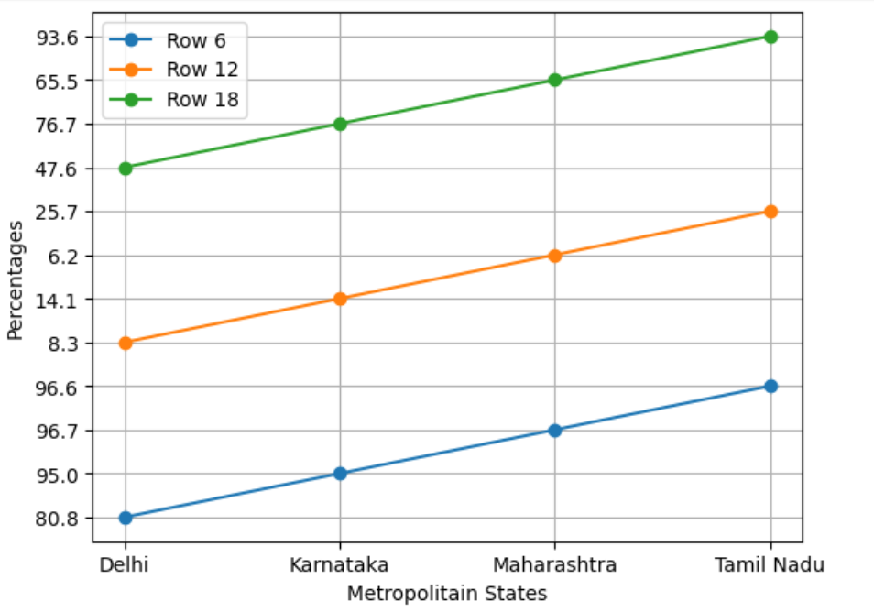
Data Analysis
TB-Diabetes Data on Metropolitain States
The line plot depicting Diabetes-TB patients with known DM status, notified diagnoses among those tested, and patients initiated on Anti-diabetic treatment in different Metropolitan States reveals notable trends. Notably, Tamil Nadu exhibits a higher percentage of diagnosed Diabetes-TB cases and demonstrates proactive measures in Anti-diabetic Treatment.
Conversely, Delhi shows a lower percentage of Diabetes-TB diagnoses and consequently lower Anti-diabetic Treatment rates.
Despite Tamil Nadu's high Anti-diabetic Treatment percentage, the overall proportion concerning TB-Diabetes diagnoses is relatively low at 9.2%. This underscores the need for targeted interventions and strategic measures in Tamil Nadu to address the situation effectively.

Slide 23
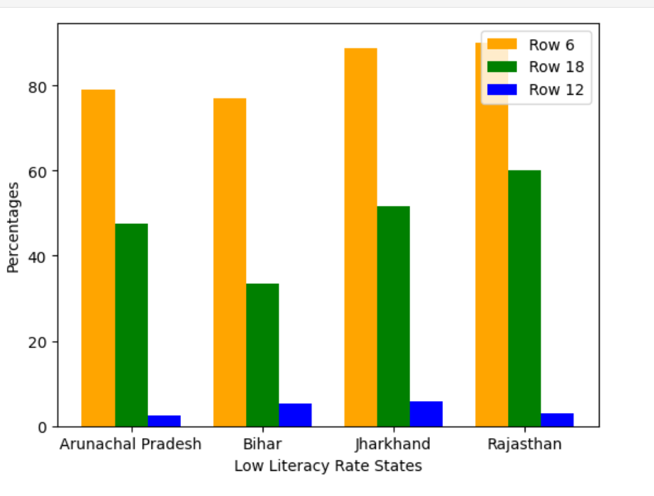
Data Analysis
TB-Diabetes Data on Low Literacy Rate States
The bar plot illustrating Diabetes-TB cases with known DM status, notified diagnoses among those tested, and patients initiated on Anti-diabetic treatment in the Least Literate States reveals discernible patterns. Notably, Rajasthan demonstrates a heightened percentage of diagnosed Diabetes-TB cases, accompanied by proactive measures in Anti-diabetic Treatment.
Conversely, Arunachal Pradesh exhibits a lower percentage of Diabetes-TB diagnoses, correlating with comparatively reduced rates of Anti-diabetic Treatment initiation.
Despite Rajasthan's commendable Anti-diabetic Treatment percentage, the overall proportion of TB-Diabetes diagnoses remains relatively modest at 33.2%. This underscores the imperative for precision-targeted interventions and strategic measures in Rajasthan to effectively address this healthcare scenario.

Slide 24
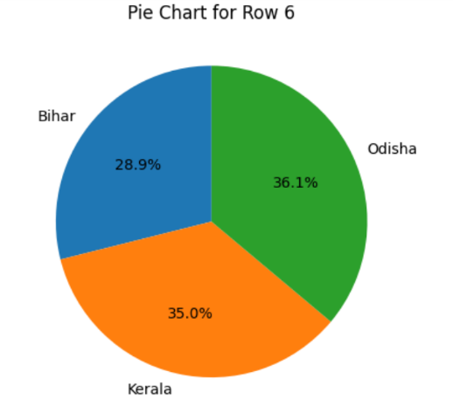
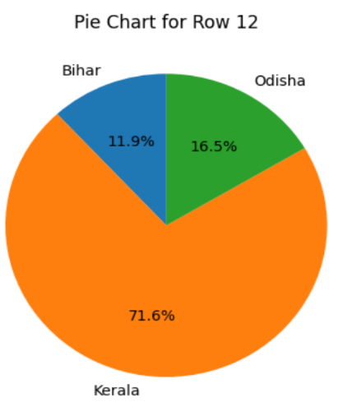
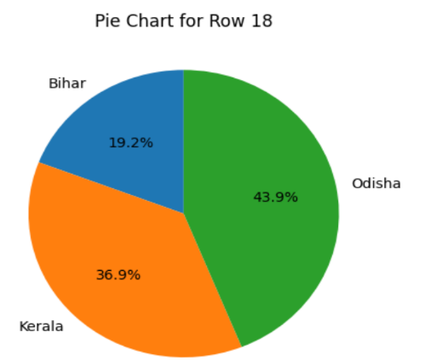
Data Analysis
TB-Diabetes Data on selected states
The enchanting visual narrative through a line plot unveils intriguing insights into Diabetes-TB dynamics, known DM status, notified diagnoses, and the initiation of Anti-diabetic treatment across selected states. In this captivating tableau, Odisha emerges as a beacon, boasting a notable surge in diagnosed Diabetes-TB cases, coupled with a laudable commitment to proactive Anti-diabetic Treatment measures.
On the other hand, Bihar gracefully takes its place with a lower percentage of Diabetes-TB diagnoses, accompanied by a modest initiation rate of Anti-diabetic Treatment.
Despite Odisha's admirable Anti-diabetic Treatment percentage, the overall proportion of TB-Diabetes diagnoses modestly rests at 27.1%. This narrative not only piques curiosity but also underscores the pressing need for nuanced, targeted interventions and strategic healthcare measures in Odisha to elevate the state's health landscape.

Slide 25
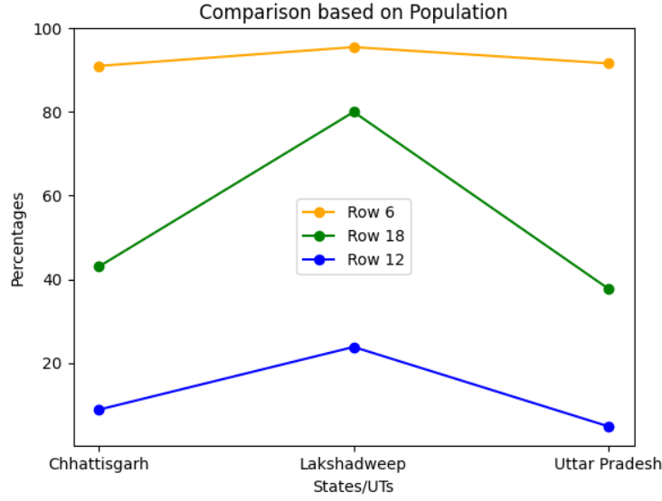
Data Analysis
TB-Diabetes Data on Population
In this line chart, we compare the proportion of patients with known tuberculosis who also suffer from Diabetes Mellitus, the percentage of TB patients who are diagnosed with DM out of the tested ones and the number of diabetic patients who are on both DM and TB medication, represented by orange, green and blue colors respectively, across 3 states.
We can see that the incidence of DM in patients who suffer from TB is fairly constant across the states compared. This matches with the overall percentage both in India and worldwide, which implies that TB may be a causative factor for DM. The diagnosis of DM in patients who already suffer from TB is almost uniform in Chhattisgarh and Uttar Pradesh, but higher in Lakshadweep. We must also note that the percentage of DM affected individuals who are undergoing treatment for both TB and DM is the highest in Lakshadweep. This might be due to its higher DM diagnosis rate, causing a correspondingly larger population size of patients taking medication for the same.

Slide 26
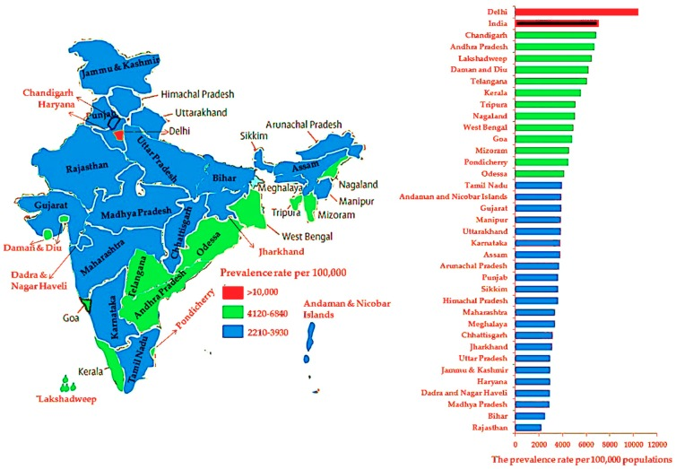
Data Analysis
TB-Diabetes Data on Population
The prevalence of diabetes across India is varied. Preliminary results from a large community study conducted by the Indian Council of Medical research (ICMR) revealed that a lower proportion of the population is affected in states of Northern India (Chandigarh 0.12 million, Jharkhand 0.96 million) as compared to Maharashtra (9.2 million) and Tamil Nadu (4.8 million). A suggested explanation for this difference is that the north Indians are migrant Asian populations and south Indians are the host populations, however this possible cause-and-effect has not been corroborated through further research. Similar ethnographic disparities have been observed in indigenous and non-indigenous populations in countries colonized by the Great Britain: indigenous people from New Zealand and Australia have been shown to suffer from diabetes and cardio-metabolic disorders more than the non-indigenous people. Further studies are required in India to highlight cultural and ethnic trends and provide a more complete understanding of the differences in diabetes etiology between Indian and other ethnic groups within India. .

Slide 27
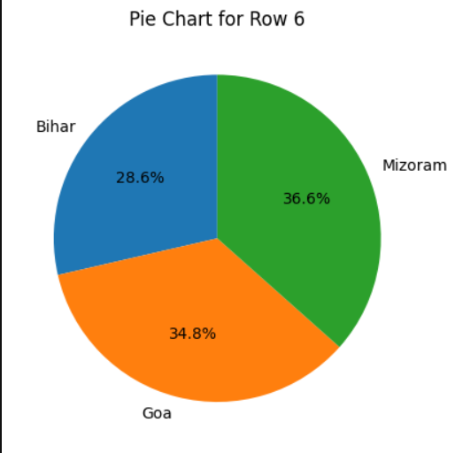
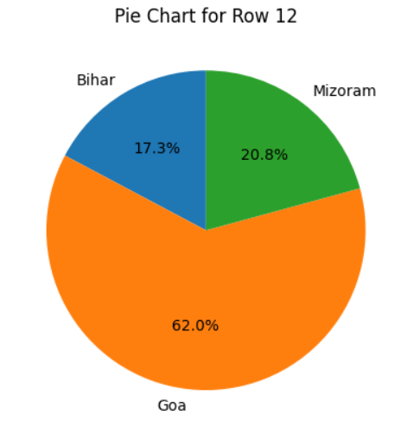
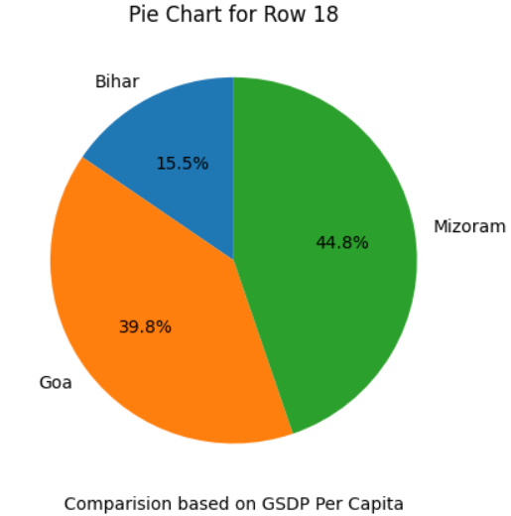
Data Analysis
TB-Diabetes Data with regards to GSDP
GSDP(Gross State Domestic Produce) is a well known indicator of economic wealth and stability. Out of the three states shown in this graph, the greatest GSDP is that of Bihar’s, followed by Goa and Mizoram. However, Bihar’s population is around 70 times greater than Mizoram and Goa. Thus, we use the GDSP per capita as a more accurate indicator represented by the X axis in this graph as the independent variable. The organization of states with respect to GDSP per capita is exactly opposite to that of just GDSP; the descending order of GDSP per capita is Goa, Mizoram and Bihar. While comparing in this way, we see that the wealthier states have higher rates of both incidence and occurrence of DM and TB. This is in agreement with published research that higher income groups are more predisposed to DM and other lifestyle related illnesses like cardiovascular disease.

Slide 28
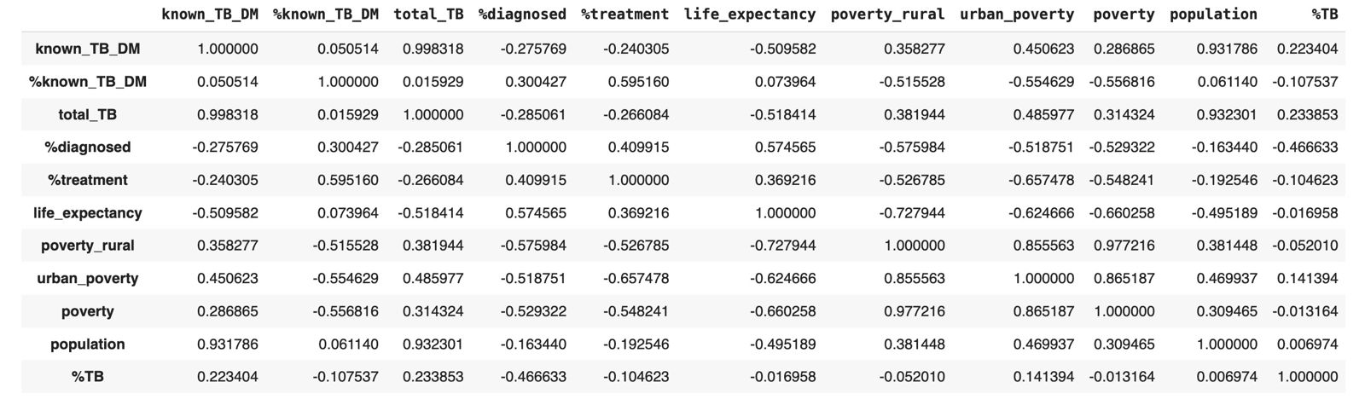
Correlation Data

Slide 29
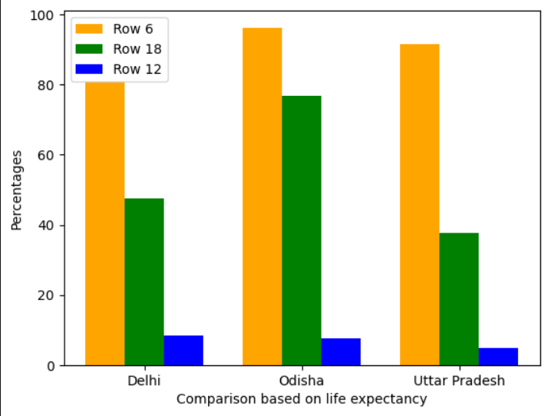
Data Analysis
TB-Diabetes Data on Life expectancy in various states
Life expectancy and DM treatment: One interesting correlation is between the percent of TB-DM diagnosed patients who were initiated on anti-DM treatment, and the life expectancy of a state (r=0.37). We believe that the former does not cause the latter, but that both are characteristics of a state with a strong healthcare system. We claim this because TB cases by themselves have a negligible impact on life expectancy, as seen by the very low correlation between life expectancy and prevalence of TB.

Slide 30
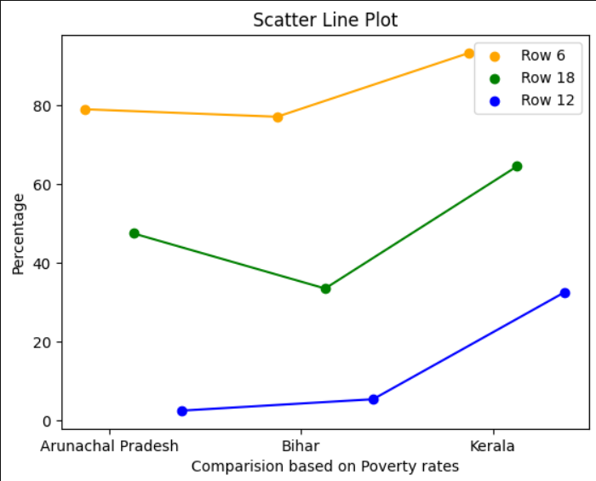
Data Analysis
TB-Diabetes Data based on Poverty Rates
Poverty: Poverty is highly negatively correlated (r=-0.55) to the proportion of TB patients whose DM status is known. This signals that poor states are short on either resources or policy, and therefore test for DM much less than their richer counterparts. This highlights an area where work must be done. Poverty is similarly negatively correlated to the proportion of TB patients diagnosed with DM, who were initiated on treatment for it. This again highlights the same issues that the poor states face.

Slide 31
Conclusion
There is a bidirectional relationship between TB and diabetes, and they both impact the presentation of each other. Diabetes is being increasingly recognized as a risk factor for TB and may affect its presentation, whilst TB may worsen glycemic control or lead to IGT among TB patients. This relationship demands adjustment in treatment and the need to employ insulin in the treatment of hyperglycemia during active TB infection when required.
The TB/DM integrated management is still evolving in India and there are challenges and opportunities. The vast network of public health facilities offers opportunities to improve the service delivery. The challenge lies in strengthening the individual programs and to envision and implement a horizontal-vertical integration. Understanding the stakeholder perspectives on the challenges and opportunities in effective integration is an important step in devising solutions. Our study points to the importance of decentralization of care and strengthening the district level coordination to enable bi-directional screening and management of TB/DM comorbidities. The disease control programs need to generate more data for better decision-making and close the skill gaps to improve integrated TB/DM management.
IGT: Impaired glucose tolerance

Slide 32
References
[1] India TB Report 2023 (Table 2.10) at https://tbcindia.gov.in/WriteReadData/l892s/5646 719104TB%20AR-2023_23-%2003- 2023_LRP.pdf
[2] Diabetes in India at WHO. https://www.who.int/india/health-topics/mobile-te chnology-for-preventing-ncds
[3] https://www.ncbi.nlm.nih.gov/pmc/articles/PMC5121697/
[4] https://www.ncbi.nlm.nih.gov/pmc/articles/PMC6843936/
[5] https://en.wikipedia.org/wiki/List_of_Indian_states_and_union_territories_by_poverty_rate
[6] https://en.wikipedia.org/wiki/List_of_Indian_states_by_life_expectancy_at_birth
Dataset: https://data.gov.in/

Slide 33
Thanks!

